Slide 1
Welcome
Class Presentation-1
Members:
Prema
Bithi
Jency

Slide 2
Knuth-Morris-Pratt (KMP) Algorithm for String Pattern Matching
Knuth–Morris–Pratt string searching algorithm (or KMP algorithm) searches for occurrences of a "word or pattern" W within a main "text string" S by employing the observation that when a mismatch occurs, the word itself embodies sufficient information to determine where the next match could begin, thus bypassing re-examination of previously matched characters. Knuth-Morris-Pratt string matching.
KMP is pattern matching algorithm which is used to search a pattern in a text.

Slide 3
We use two terms, Pattern and Text/String
Pattern: The string of characters we want to search
Text: The Data in which we want to search for that pattern
How KMP works:
1. Every character in Pattern is compared with characters in Text
2. If all characters in Pattern are matching with characters in text, then search success
3. If any mismatch found then, shift the pattern according to
Prefix Table and continue with comparison

Slide 4
The General Pattern matching System:
1 2 3 4 5 6 7 8
This algorithm takes O(m*n) time.
String:
a b c d e f g h
d e f
d e f
d e f
d e f
Pattern: d e f
i
i
i
i
i
i
String:
a | b | c | d | e | f | g
1 | 2 | 3 | 4 | 5 | 6 | 7
Is String[i] == pattern[j]
If Yes j++ and i++
If No then reset j =0 and i++
Pattern:
d | e | f
1 | 2 | 3
j
j
j
Hence, pattern: def is found in the String: abcdefg

Slide 5
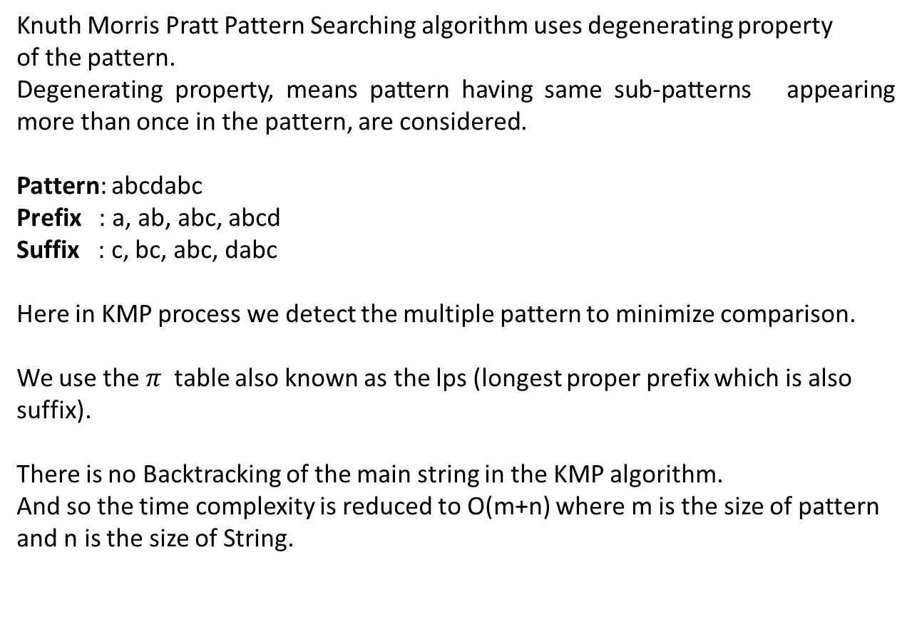
Knuth Morris Pratt Pattern Searching algorithm uses degenerating property
of the pattern.
Degenerating property, means pattern having same sub-patterns appearing more than once in the pattern, are considered.
Pattern: abcdabc
Prefix : a, ab, abc, abcd
Suffix : c, bc, abc, dabc
Here in KMP process we detect the multiple pattern to minimize comparison.
We use the $π$table also known as the lps (longest proper prefix which is also suffix).
There is no Backtracking of the main string in the KMP algorithm.
And so the time complexity is reduced to O(m+n) where m is the size of pattern and n is the size of String.
abc is common sub-pattern

Slide 6
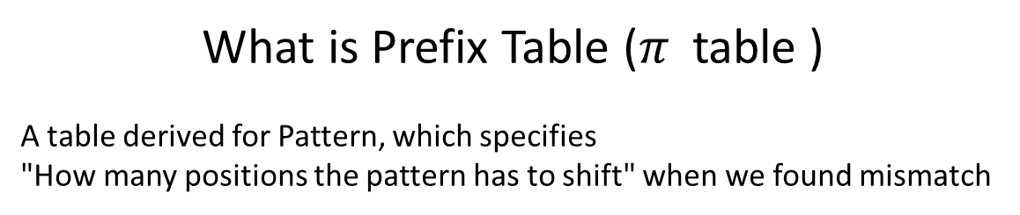
What is Prefix Table ($π$table )
A table derived for Pattern, which specifies
"How many positions the pattern has to shift" when we found mismatch
1 | 2 | 3 | 4 | 5 | 6
a | b | b | a | b | b
0 | 0 | 2 | 1 | 2 | 3
Example:
Index | 1 | 2 | 3 | 4 | 5 | 6 | 7
Pattern [j] | A | B | C | D | A | B | E
LPS[i] | 0 | 0 | 0 | 0 | 1 | 2 | 0

Slide 7
Preprocessing the Pattern:
We need to preprocess a pattern string before searching for it in the main string.
Preprocessing involves constructing an Ips array corresponding to the pattern string of same size as the pattern string.
Name Ips indicates longest proper prefix which is also suffix.
For example, proper prefixes of "ABC" are "", "A" and "AB" and not
"ABC". Same for suffix
Steps for Creating LPS Table (Prefix Table)
Step 1 - Define a one dimensional array with the size equal to the length of the Pattern. (LPS[size])
Step 2 - Define variables i & j. Set i = 0, j = 1 and LPS[0] = 0.
Step 3 - Compare the characters at Pattern[i] and Pattern[j].
Step 4 - If both are matched then set LPS[j] = i+1 and increment both i & j values by one. Goto to Step 3.
Step 5 - If both are not matched then check the value of variable 'i'. If it is '0' then set LPS[j] = 0 and increment 'j' value by one, if it is not '0' then set i = LPS[i-1]. Goto Step 3.
Step 6- Repeat above steps until all the values of LPS[] are filled.

Slide 8
i
i
i
i
i
i
i
i
i
i
i
i
i
String:
a | b | a | b | c | a | b | c | a | b | a | b | d
1 | 2 | 3 | 4 | 5 | 6 | 7 | 8 | 9 | 10 | 11 | 12 | 13
Size: n
Time complexity reduced to O(m+n)
j
j
j
j
j
If(String[i] == Pattern[j+1]){
j++;
i++;
}
Size: m
Pattern:
0 | 1 | 2 | 3 | 4 | 5
X | a | b | a | b | d
X | 0 | 0 | 1 | 2 | 0
LPS
elseif(String[i] != Pattern[j+1]){
Move j to the index from table;
}
elseif((String[i] != Pattern[j+1] )&&j==0){
i++;
}
Found the pattern in String
Elseif((j+1)== pattern.size()){
Found pattern in String
}

Slide 9
Advantages
Below are the advantages:
The most obvious advantage of KMP Algorithm – data is that it’s guaranteed worst-case efficiency as discussed.
The pre-processing and the always-on time is pre-defined.
There are no worst-case or accidental inputs.
Preferable where the search string in a larger space is easier and more efficiently searched due to it being a time linear algorithm.
The algorithm needs to move backward in the input text. This is particularly favorable in processing large files.

Slide 10
Disadvantages
Below are the disadvantages:
One of the glaring disadvantages of KMP Algorithm – data is that it doesn’t work well when the size of the alphabets increases. Due to this more and more error occurs.
For processing very large files it also requires resources in the form of processors and that could be a problem for smaller organizations to adopt KMP Algorithm – data
Some references:
http://www.btechsmartclass.com/data_structures/knuth-morris-pratt-algorithm.html
https://brilliant.org/wiki/knuth-morris-pratt-algorithm/
https://www.javatpoint.com/daa-knuth-morris-pratt-algorithm

